Slide 1
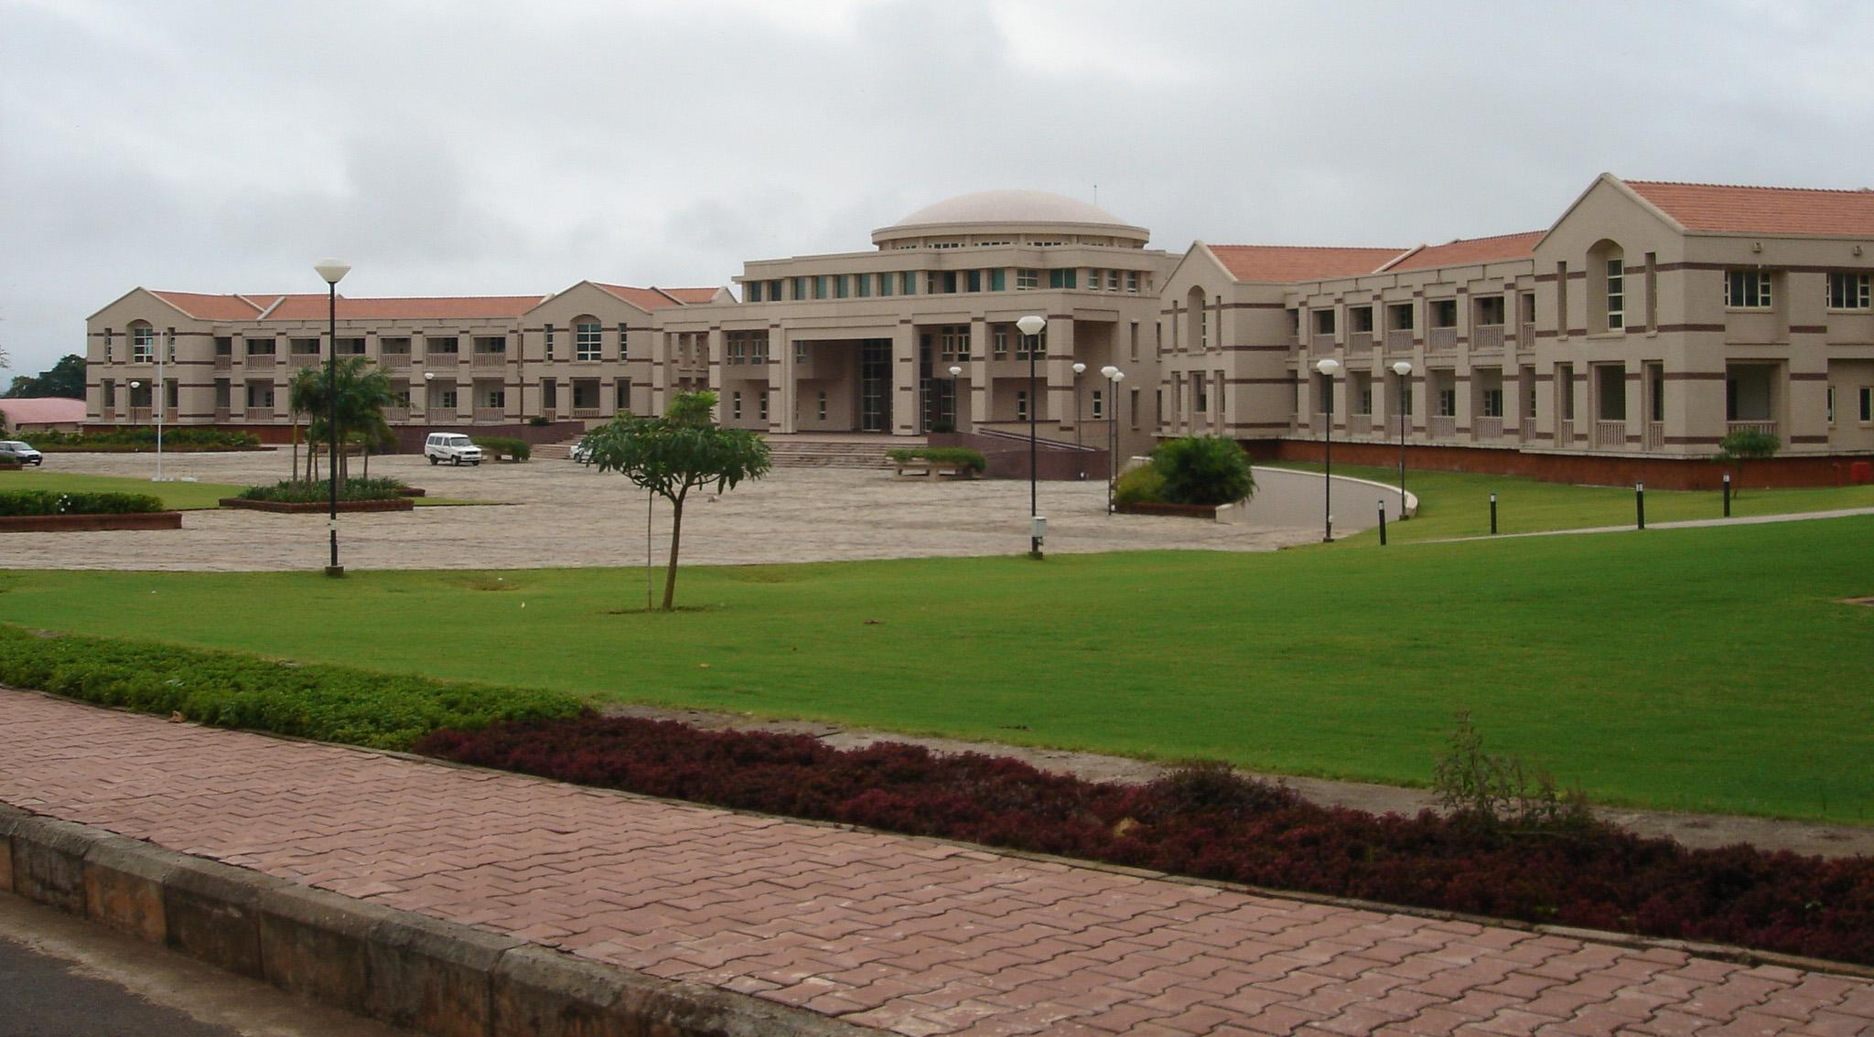

ECONOMIC ANALYSIS OF PMJDY
Viraj V Aute
Laxman Zanwar Aryan Makharia Siddharth Upadhyay Prakhar Singhal
BITS Pilani
Instructor-in-Charge: Prof. Mridula Goel
Department of Economics and Finance
K K Birla Goa Campus

Slide 2
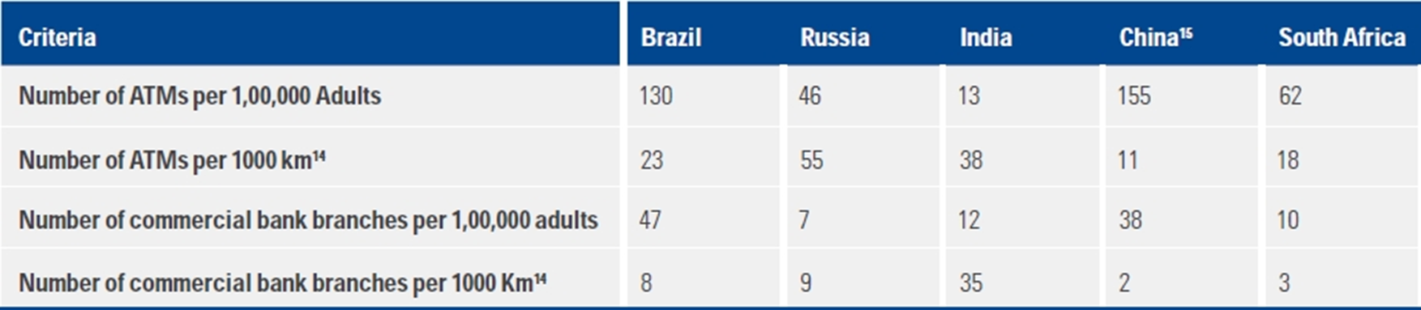
INTRODUCTION
The Policy was Launched in Aug 2014
The primary aim of the Jan Dhan Yojana is to bring poor financially excluded people into the banking system by providing them bank accounts and debit cards.
Source : https://assets.kpmg/content/dam/kpmg/in/pdf/2017/10/PMJDY.pdf

Slide 3
KEY FEATURES OF PMJDY
Universal access to banking facilities
Basic Savings Bank Deposit (BSBD) accounts with overdraft facility and RuPay debit card to all households
Financial literacy program
Creation of Credit Guarantee Fund
Sources :
https://www.microsave.net/2020/05/06/pradhan-mantri-jan-dhan-yojana-pmjdy-ideas-and-lessons-from-india/

Slide 4
LOGICAL FRAMEWORK ANALYSIS
ACTIVITIES/INPUTS
A) Providing timely and adequate credit to all (Financially Weaker Section) B) Ensuring access to affordable financial services | 1) Access to bank accounts and debit cards to financially poor
 | 2) Ensuring that Bank accounts are active
 | 3) Increasing Financial Literacy and credit counselling (with the help of bank Mitras and Financial Literacy Centres)
 | 4) Micro-insurance policies to provide for a risk or insurance coverage to economically vulnerable sections of society
 | 5) Overdraft Facility (Rs. 5000, now increased to Rs. 10000 )
 | 6) Integration with Swavalanbam Scheme to provide unorganized sector pension benefits
Source : https://www.pmjdy.gov.in/scheme

Slide 5
LOGICAL FRAMEWORK ANALYSIS
OUTPUTS
People from weaker sections of society get the benefit of formal credit and insurance facilities. | 1) Targeted number of bank accounts & bank branches setup
 | 2) Outreach of the policy
 | 3) Overall Increase in transactions
 | 4) Growth in the volume of deposits and credits
 | 5) Financial Literacy (Usage of Financial Services)
 | 6) Number of people getting insured

Slide 6
LOGICAL FRAMEWORK ANALYSIS
OUTCOMES
1) Increase in usage of technology to make banking more efficient
2) Increase in Demand for equipment such as ATM's, Smart-Cards, Biometric devices
3) Easy accessibility to policies such as PMJJBY, APY, etc.
4) Expansion of Bank's Size
5) Embracement of Aadhaar
IMPACTS
1) Increase in Transparency, hence reduction of corruption
2) Foundation of a cashless economy (Digital India)
3) Facilitates economic growth by reallocating human resources into a more productive sector
Source: https://journals.pen2print.org/index.php/ijr/article/view/10888

Slide 7
Stakeholder Analysis
SR. NO. | NAME OF THE GROUP | GROUP INTEREST IN ISSUE | RESOURCES AVAILABLE | CAPACITY TO MOBILIZE RESOURCE | POSITION ON ISSUE
1) | Department of Financial Services | Implementing and performing a Project Management role in the PMJDY | Political Influence, Information Access | Medium | +2
 |  | Acting as a Central Advisory Board to guide other stakeholders
2) | RBI | To guide and support banks | Financial Aid, Political Influence, Authority on policy | High | +2
 |  | Financial Inclusion Fund (FIF) allocation support

Slide 8
SR. NO. | NAME OF THE GROUP | GROUP INTEREST IN ISSUE | RESOURCES AVAILABLE | CAPACITY TO MOBILIZE RESOURCE | POSITION ON ISSUE
3) | NABARD | Monitoring and financial Aid | Financial Aid, Authority | High | +2
4) | Banks | Expanding Banking facilities to the beneficiaries | Workforce, Credit Resources, Information Access | Medium | +1
 |  | Setting up Financial Literacy and Credit Counselling centers.

Slide 9
SR. NO. | NAME OF THE GROUP | GROUP INTEREST IN ISSUE | RESOURCES AVAILABLE | CAPACITY TO MOBILIZE RESOURCE | POSITION ON ISSUE
5) | NPCI (National Payments Corporation of India) | Providing necessary technology support to Banks in making USSD based mobile banking a reality. | Technological Infrastructure (Payment platform), Skilled Workforce | High | +1
 |  | Support Banks for providing proper operations of RuPay cards.
6) | Donor | Utilizing of Tax Money | Media Influence | Low | -1
 |  | Dilution of Quality of banking services for them

Slide 10
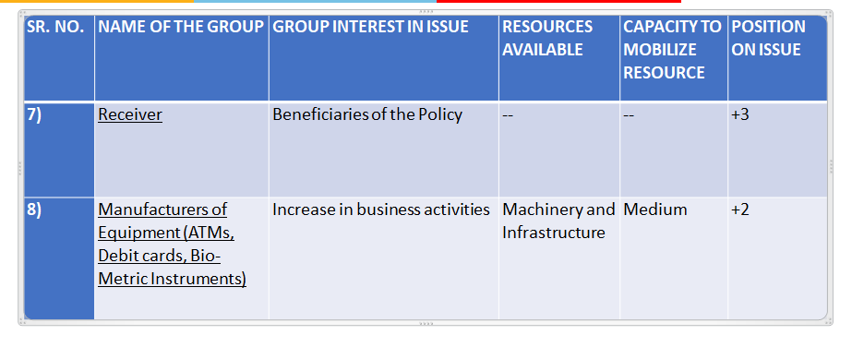

Slide 11




SWOT ANALYSIS

Slide 12
STRENGTHS
Zero balance bank account
RuPay debit card issuance
Life insurance cover of Rs 30,000 and Accident cover of Rs 2,00,000 ^{[1]}
Rs 10,000 overdraft provided after six months of account opening ^{[2]}
Simple process for account opening. Aadhaar card alone is sufficient for account opening
Account holder's money is more secured in bank accounts
Direct Benefit Transfers can be smoothly credited
^{[1]} Source: https://www.pmjdy.gov.in/insurance
^{[2]} Source: https://www.rbi.org.in/scripts/FS_Notification.aspx?Id=11604&fn=2754&Mode=0

Slide 13
WEAKNESS
Inadequate numbers of FLCs (Financial Literacy Centres)
Lack of infrastructure (bank branches, ATM centres)
Unavailability of electricity and uninterrupted broadband connectivity
Lack of participation by private banks
Accident cover is valid as long as the account holder uses the RuPay debit card once in 90 days ^{[2]}
Life cover of Rs 30,000 will be available only for five years to one person per family ^{[1]}
^{[1]} https://www.pmjdy.gov.in/files/QuickLinks/Circular-RuPay-Insurance-Program-2019-20.pdf
^{[2]}https://www.businesstoday.in/sectors/banks/government-extends-rupay-card-insurance-claim-to-90-days/story/226431.html

Slide 14
OPPORTUNITIES
RBI has set a roadmap for financial inclusion
Policy promotes insurance penetration, thereby providing a safety net to the poor
Essential for the Digital India initiative taken by the country
Through Direct benefit transfer unnecessary waste and corruption (reducing leakages) can be reduced
This policy complements previous schemes under financial inclusion, such as microfinancing

Slide 15
THREATS
Unawareness of ATM’s in rural India
Biggest challenge is to increase transactions.
No proper clarification is given about the recovery of overdraft and the cost to the account holders
No proper clarification about the associated costs of insurance
Existing saving accounts holders without RuPay card cannot get other benefits
Lack of budgetary provisions to provide incentives can lead to trouble in the financial position of banks

Slide 16
Force Field Analysis
Driving Forces
Restraining Forces
INCREASE
FINANCIAL
INCLUSION
IN INDIA
Direct benefit transfer helps to increase transparency in the system
Very difficult to increase transactions as accounts might not be active
4
3
Universal access to banking facilities
Increases money supply in the economy
Not enough infrastructure for the development of Financial literacy centres, ATMs, internet Connectivity
3
2
Ease of implementation of other Policies
Insurance facility for the weaker section of the society
Monitoring duplicate bank accounts can be challenging
2
2
Difficulty in coordinating among the various bodies
People from weaker sections may find it challenging to use the banking facilities
Account can be easily opened with just an Aadhar card.
Easy credit to the weaker section
of society.
16
9
1
1

Slide 17
Cost Effectiveness Analysis
ITEM | 2014 | 2015 | 2016 | 2017 | 2018 | 2019
Beneficiaries | 104482469 | 198384533 | 260322099 | 307951262 | 336568327 | 377650669
RuPay beneficiaries | 84630731 | 168451374 | 199301288 | 232260470 | 268713803 | 297303820
Newly added beneficiaires | 84630731 | 83820643 | 30849914 | 32959182 | 36453333 | 28590017
Branches operational | 2644.5 | 4367 | 5496.5 | 5011.5 | 4984 | 5826
Operating Cost of All Branches (Rs cr) | 5870.79 | 10175.11 | 13961.11 | 13831.74 | 14104.72 | 19051.02
Deposit earning (Rs cr) | 1001.572804 | 3504.145004 | 8579.79281 | 8572.989684 | 10349.86308 | 12937.70226
Insurance Cost (Rs cr) | 9.477587998 | 10.23888278 | 5.034065392 | 6.590787945 | 8.968963234 | 8.474368796
Overdraft cost (Rs cr) | 0 | 11.66 | 16.907 | 9.911 | 23.32 | 25.8269
Advertising (Rs cr) | 20 | 20 | 20 | 20 | 20 | 10
TOTAL Cost (Rs cr) | 4898.694784 | 6701.203879 | 5406.351256 | 5285.341104 | 3783.825883 | 6131.792107
https://docs.google.com/spreadsheets/d/1u8lRQmF78w3iYSpbefvkFlXLNqq95lAcxm3tDM3Far8/edit?usp=sharing

Slide 18
Cost Effectiveness Analysis
1) No. of Beneficiaries and No. of RuPay Beneficiaries- No. of Beneficiaries is the total number of bank accounts opened under PMJDY in that particular year. But only RuPay card holders are entitled to Insurance, Overdraft benefits. Source - https://www.pmjdy.gov.in/Archive
2) Bank Branches, Bank Branches opened due to PMJDY and Cumulative sum of Branches -Bank Branches represents the total number of banks in rural India. To find the bank branches opened due to PMJDY, we assumed that 50% of newly opened branches in a specific year is due to PMJDY. The cumulative sum of Branches is from 2014 -2019.
Source - https://rbi.org.in/scripts/AnnualReportPublications.aspx?Id=1288
3) Average Operating Cost of a Branch- We considered the top 3 banks participating in the scheme and found each bank's average operating cost, and then took the weighted average cost of it. Source – https://www.moneycontrol.com/financials/bankbaroda/profit-lossVI/BOB#BOB

Slide 19
Cost Effectiveness Analysis
4) Insurance cost per person and insurance cost- Insurance cost was found by using the formula Insurance cost= Insurance cost per person * No. of Beneficiaries * Insurance claim percentage.
Insurance claim percentage was found from the article given in source about 2018 data.Source - https://economictimes.indiatimes.com/industry/banking/finance/insure/over-5000-life-insurance-claims-under-pmjdy-so-far-rtireply/articleshow/62921237.cms?from=mdr#:~:text=It%20also%20said%20that%20under,paid%20to%202%2C340%20eligible%20claimants
https://www.irdai.gov.in/ADMINCMS/cms/Uploadedfiles/Hand%20Book%202019-20.pdf
5) Overdraft Availed and Overdraft cost- Data source for Overdraft Availed under PMJDY scheme is mentioned. Overdraft was calculated using formula-
Overdraft cost = overdraft availed* default rate on overdraft.
We assumed the default rate on overdraft as the average default rate on loans in rural India,which was 5.8%. Source - https://rbi.org.in/scripts/AnnualReportPublications.aspx?Id=1288,
https://www.dvara.com/research/wp-content/uploads/2013/04/Cost-of-Delivering-Rural-Credit-in-India.pdf15

Slide 20
Cost Effectiveness Analysis
6) Advertisement Cost- The Below article tells us that about Rs100cr would be spent on PMJDY advertisement. So we divided it into five years (2014-2018 initially stated duration of the program )
Source - https://economictimes.indiatimes.com/industry/services/advertising/pms-jandhan-yojana-government-to-spend-more-than-rs-100-crore-on-advertising-thescheme/articleshow/41552796.cms
7) Total cost – was calculated using the formula –
Total cost = Operating cost of all branches – Deposit Earning of Bank + OverDraft Cost+
Insurance Cost + Advertisement Cost.

Slide 21
Present Value of the Cost
 | 2014 | 2015 | 2016 | 2017 | 2018 | 2019
TOTAL Cost | 4898.69 | 6701.20 | 5406.35 | 5285.34 | 3783.82 | 6131.79
Int rate |  | 0.0755 | 0.06233 | 0.0522 | 0.04685 | 0.064
Disc factor | 1 | 1.075 | 1.142 | 1.202 | 1.258 | 1.339
Present Value (Rs cr) | 4898.69 | 6230.78 | 4731.89 | 4396.48 | 3006.62 | 4579.24 | 27843.69
The Total number of Beneficiaries till 2019 was 37.76 crores. Average Cost per Beneficiary turns out to be Rs 737.3. As a result of this policy % of population financially covered increase from 35% in 2010 to 83% in 2018.

Slide 22
Intangible Benefits
The opening of bank accounts of every individual helps in implementation of other policies like PMJJBY, Atal Pension Yojana, etc.
It would reduce the leakages happening in the system due to middle-man and corruption. Ex- Government can effectively use the facility of Direct Benefit Transfer.
As the policy benefits weaker sections, it will improve the condition of the unorganized sector of the country.

Slide 23
Thank You

